Slide 1
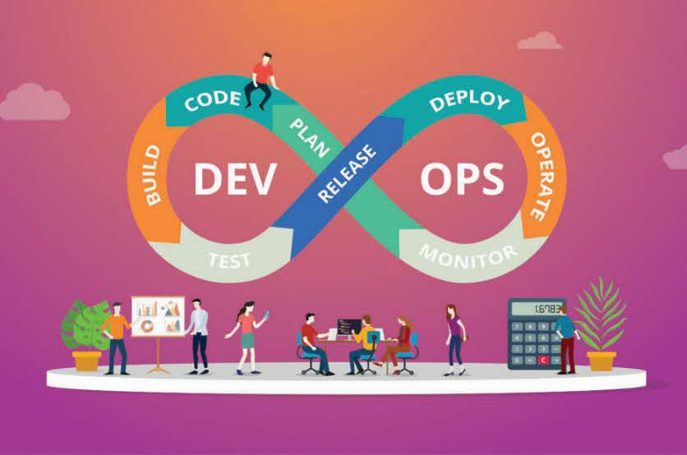
#arkmars
Squad #5
Members
Arup Sen (398885) - 1
Karuk Sharma (1569687) - 2
Manojkumar Selvaraju (204968) - 3
Razbir Pathania (148232) - 4
Sujay Saboo (392014) - 5

Slide 2
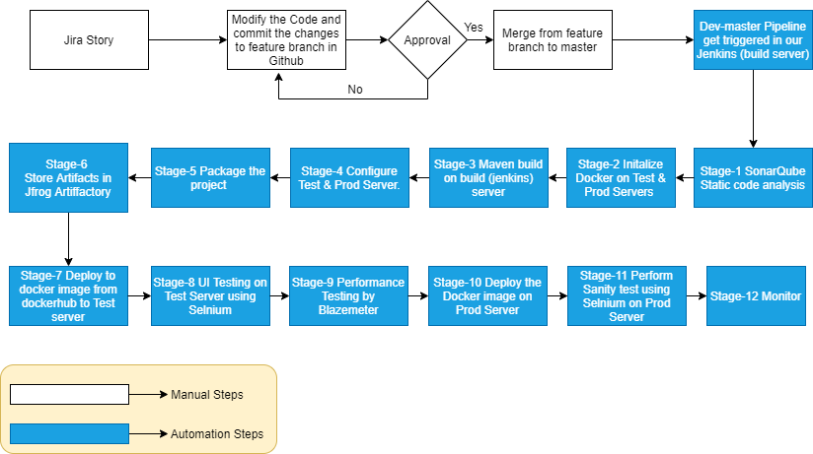
Work flow

Slide 3
Provisioning of Infra using Playbook

Slide 4
JIRA Story Creation

Slide 5
Git Hub Merge

Slide 6
Pipeline - Explain script

Slide 7
Execution of Pipeline

Slide 8
Integrations with Slack, Jira, Artifactory

Slide 9
